Slide 1


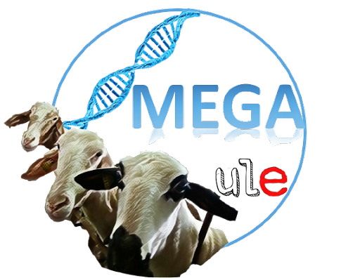
Genomic Annotation in Livestock for positional candidate LOci: GALLO
Dr. Pablo Augusto de Souza Fonseca
October 17th, 2023

Slide 2
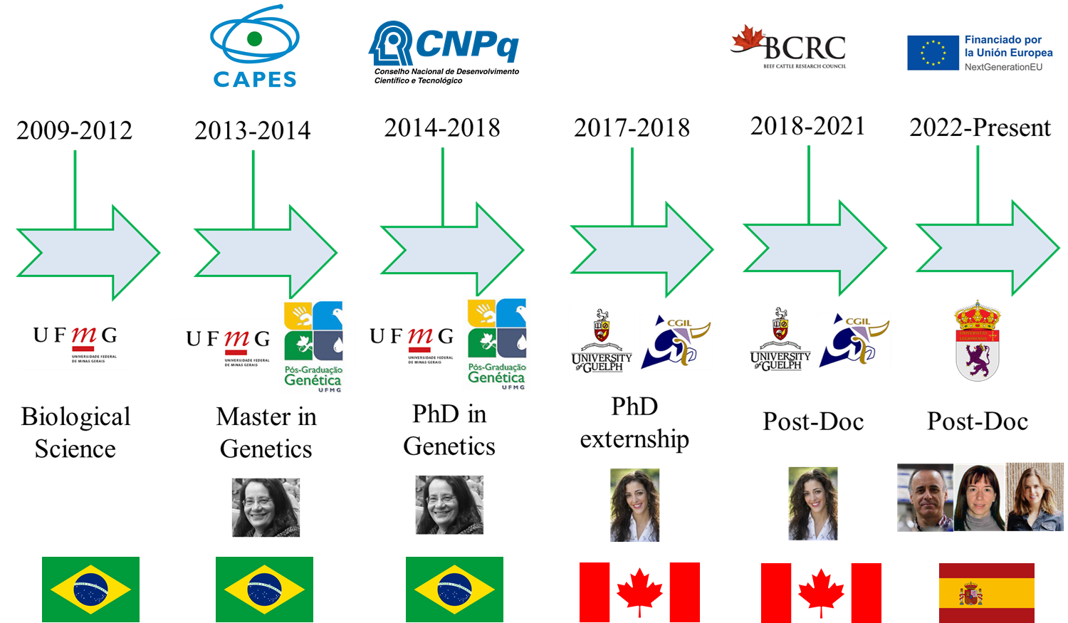
About me

Slide 3
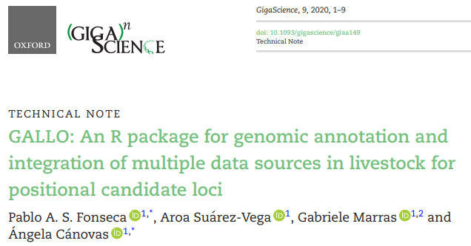

GALLO

Slide 4
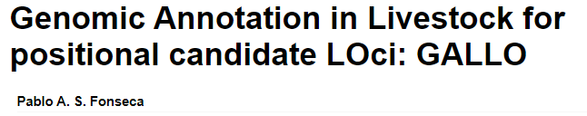



What is GALLO?
https://cran.r-project.org/web/packages/GALLO/vignettes/GALLO.html
Accurate annotation of genes and Quantitative Trait Loci (QTLs) located within candidate markers and/or regions (haplotypes, windows, CNVs, etc) identified in the most common genomic analyses performed in livestock, such as GWAS or transcriptomics.

Slide 5
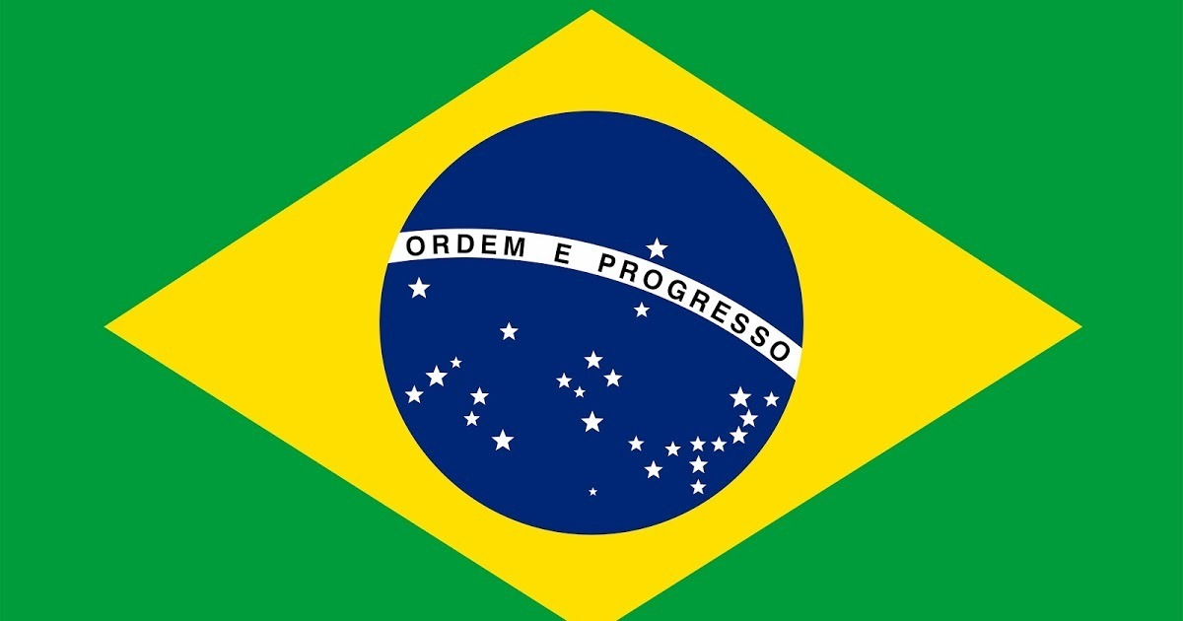



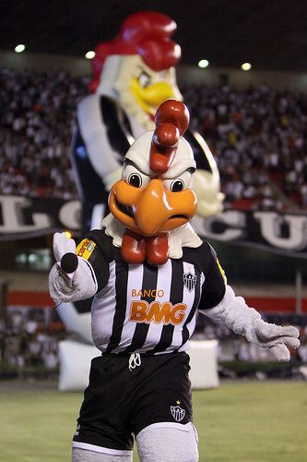
Why GALLO?
GALO – GALLO
ROOSTER

Slide 6


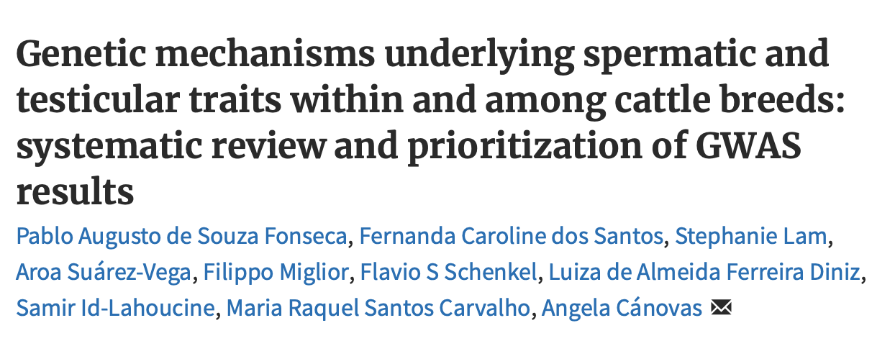
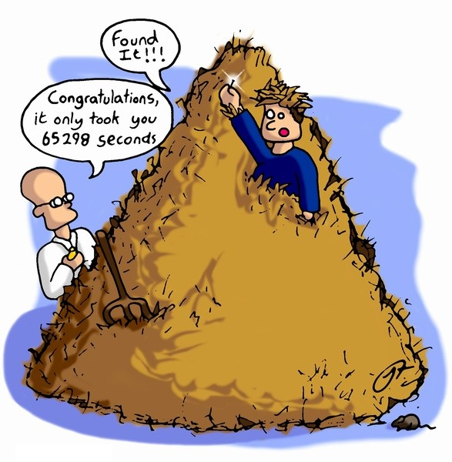
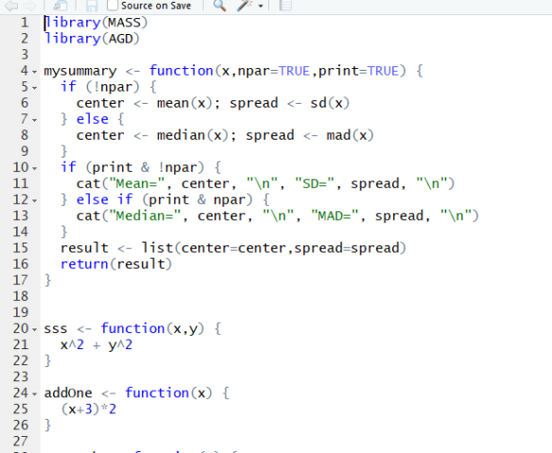
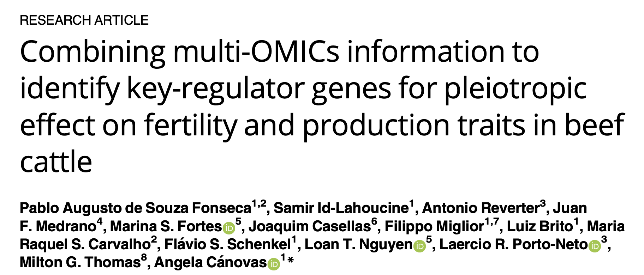
From where GALLO came from?
PhD projects

Slide 7
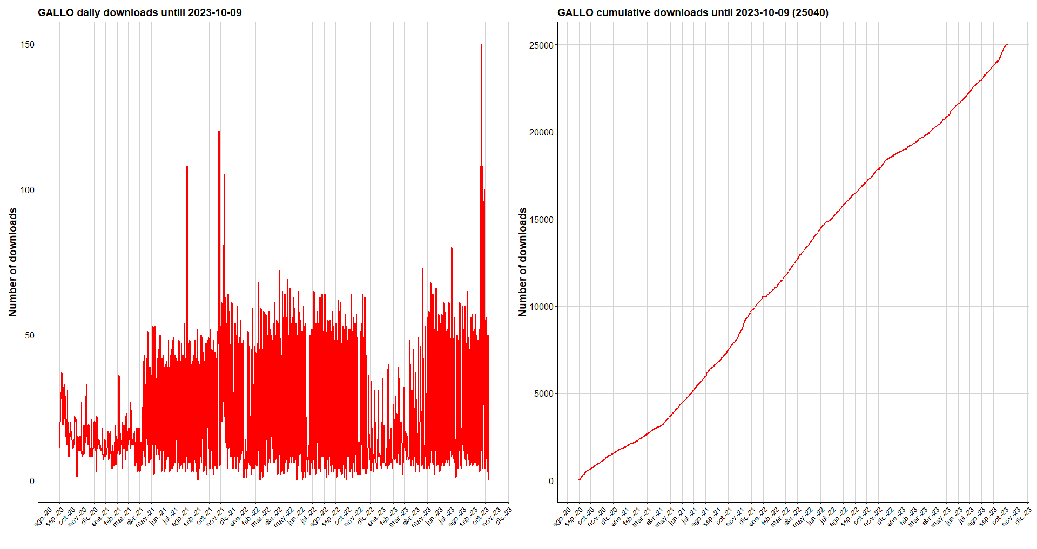
GALLO downloads and citations
Since 2020
>25K downloads
>65 citations

Slide 8
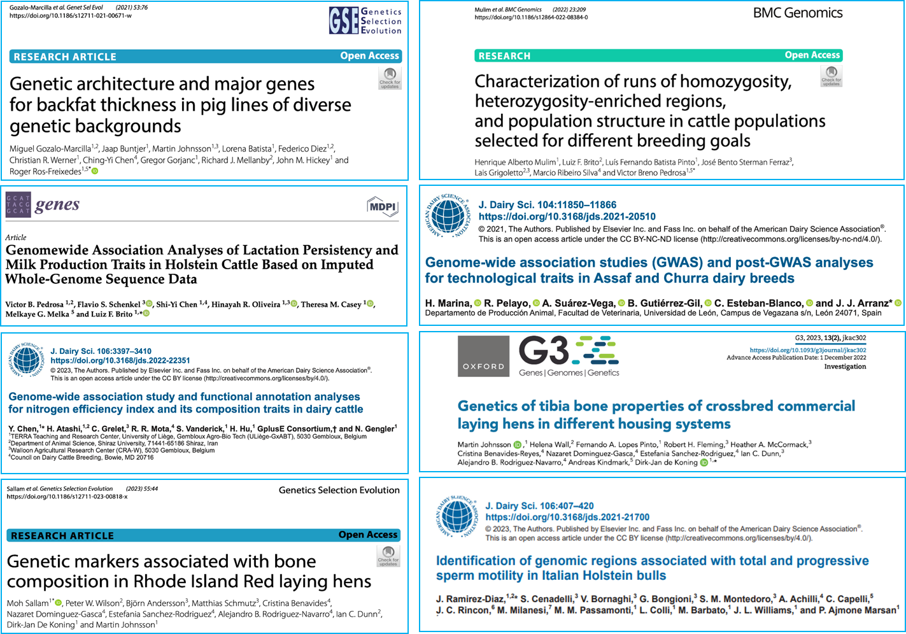
Studies using GALLO

Slide 9
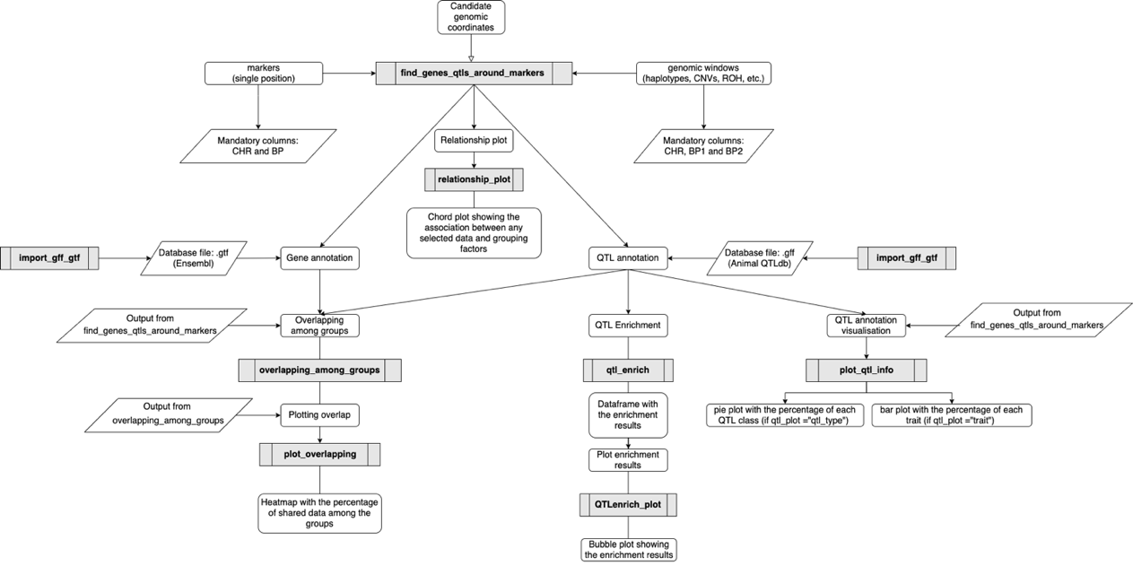
What does GALLO?
Main Functions
8 Functions connected in a straightforward logic

Slide 10
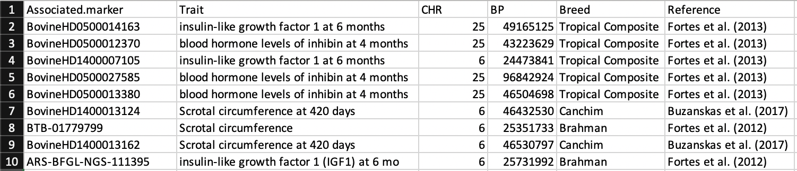
Gene and QTL Annotation
Input file
Using marker coordinates:
The columns CHR and BP are mandatory
The user can include as many additional columns as it is needed
Using window coordinates:
The columns CHR, BP1 and BP2 are mandatory

Slide 11
Gene and QTL Annotation
Input file
Subset of 527 SNPs significantly associated with male fertility traits
Feugang et al. (2009)
Single marker coordinates
Annotation using 200 Kb interval
UMD 3.1
Male non-compensatory fertility
Buzanskas et al. (2017)
Scrotal circumference at 420 days

Slide 12
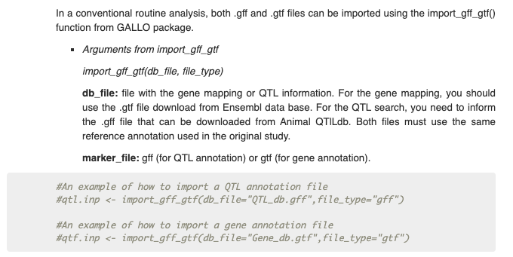

Gene and QTL Annotation
import_gff_gtf(db_file, file_type)
.gff file
.gtf file

Slide 13
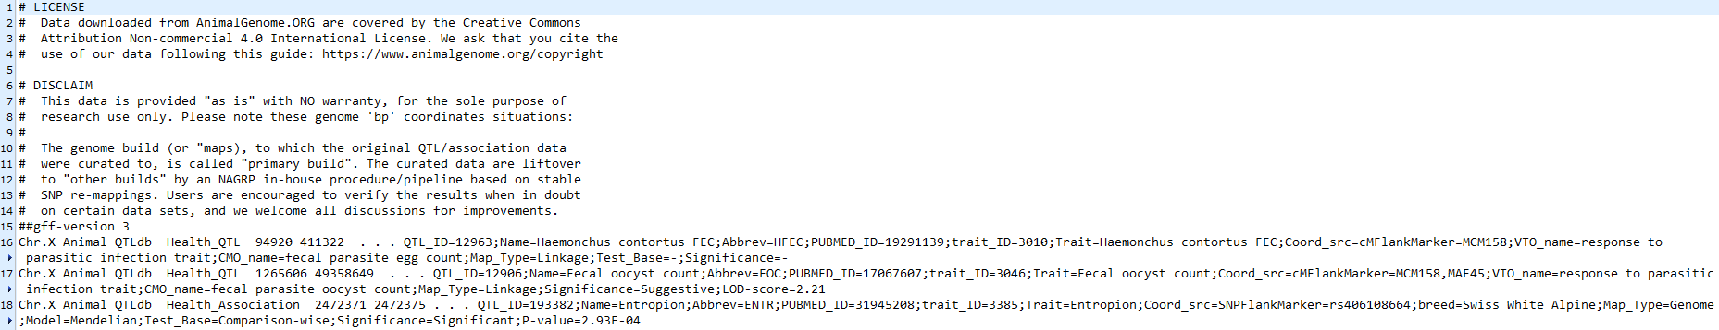
Gene and QTL Annotation
gff (General Feature Format) file
Format consists of one line per feature:
Each line represents one QTL

Slide 14
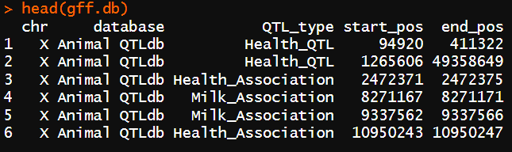
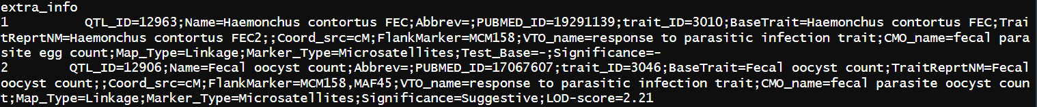
Gene and QTL Annotation
gff (General Feature Format) file
Processed by inner function to create new columns in the output

Slide 15
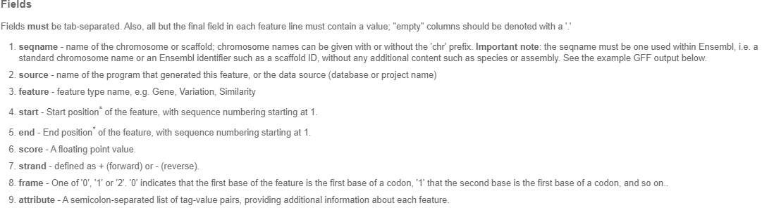
Gene and QTL Annotation
gtf (General Transfer Format) file
Format consists of one line per feature, each containing
9 columns of data, plus optional track definition lines

Slide 16
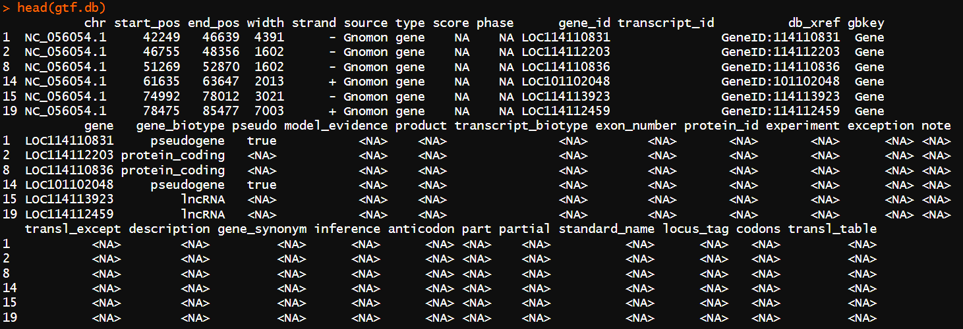
Gene and QTL Annotation

Slide 17
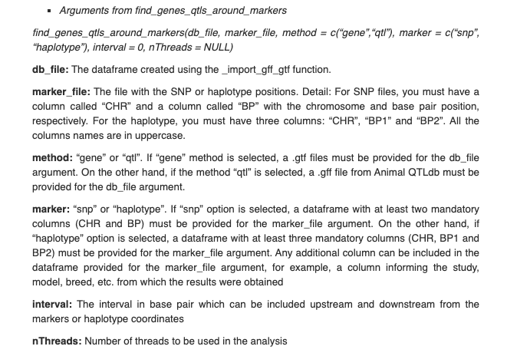
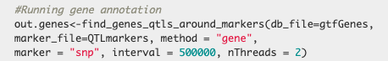
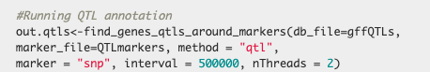
Gene and QTL Annotation
find_genes_qtls_around_markers(db_file, marker_file, method = c(“gene”,“qtl”), marker = c(“snp”, “haplotype”), interval = 0, nThreads = NULL)
dim(out.genes) → 652 15
dim(out.qtls) → 3020 24

Slide 18
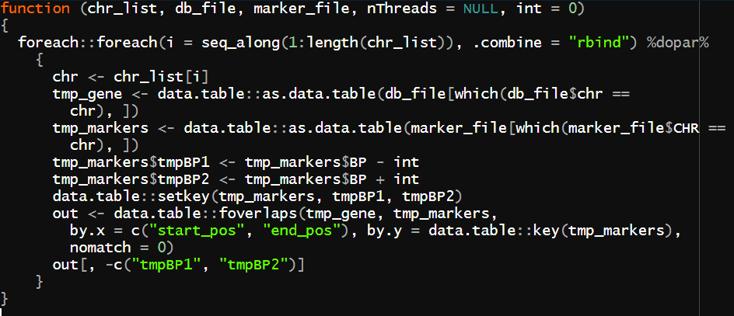
Gene and QTL Annotation
Based on data.table foverlaps function
Fast binary-search based overlap join
527 SNPs coordinates (400 Kb interval)
Genes
QTLs
GALLO: 0.424 sec.
Biomart: 0.019 sec.
GALLO: 0.851 sec.
Bedtools: 0.120 sec.

Slide 19
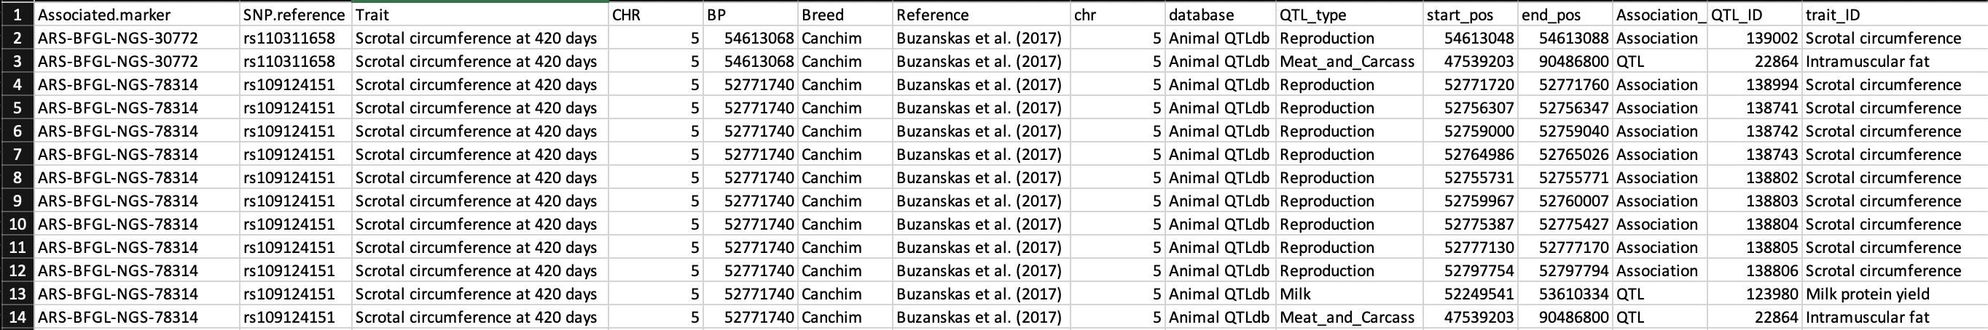
Main advantages
Same environment
Output structure (include any additional information, such as comments and group classification)

Slide 20
Troubleshooting
Check if the importation process worked properly
Check if you are using gff to QTL annotation and gtf to gene annotation
Chromosomes must have the same code pattern in input and db files
In some gff files, there are start coordinates larger than end coordinates, switch the coordinates to fix the error
Custom gtf and gff files can be uploaded manually and used to annotation (mandatory columns must have the same name)

Slide 21
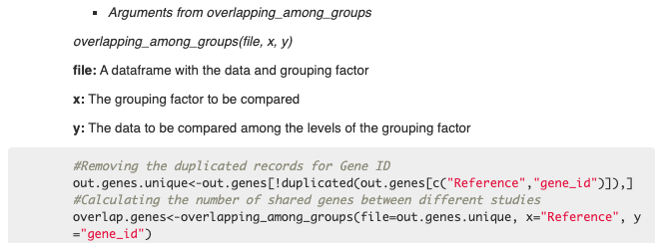
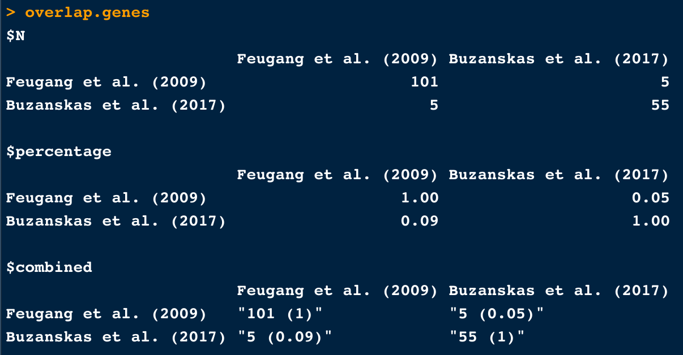
Checking and plotting overlap among groups
overlapping_among_groups(file, x, y)
Output composed by 3 matrices
Number of shared records
Percentage of shared records (non-symmetrical)
Hybrid matrix

Slide 22
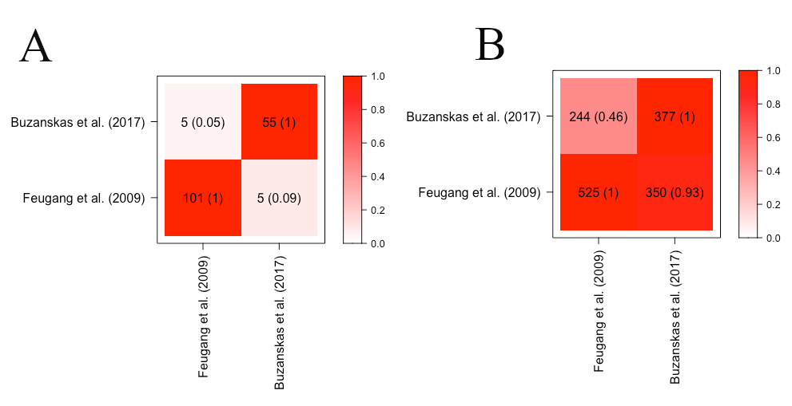
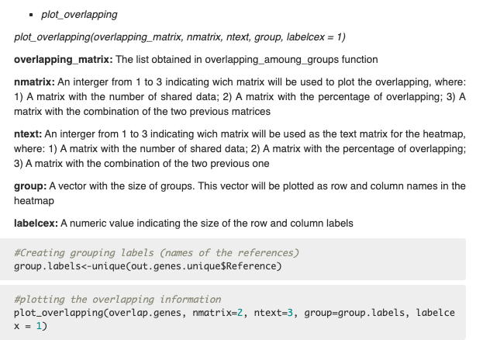
Checking and plotting overlap among groups
plot_overlapping(overlapping_matrix, nmatrix, ntext, group, labelcex = 1)

Slide 23
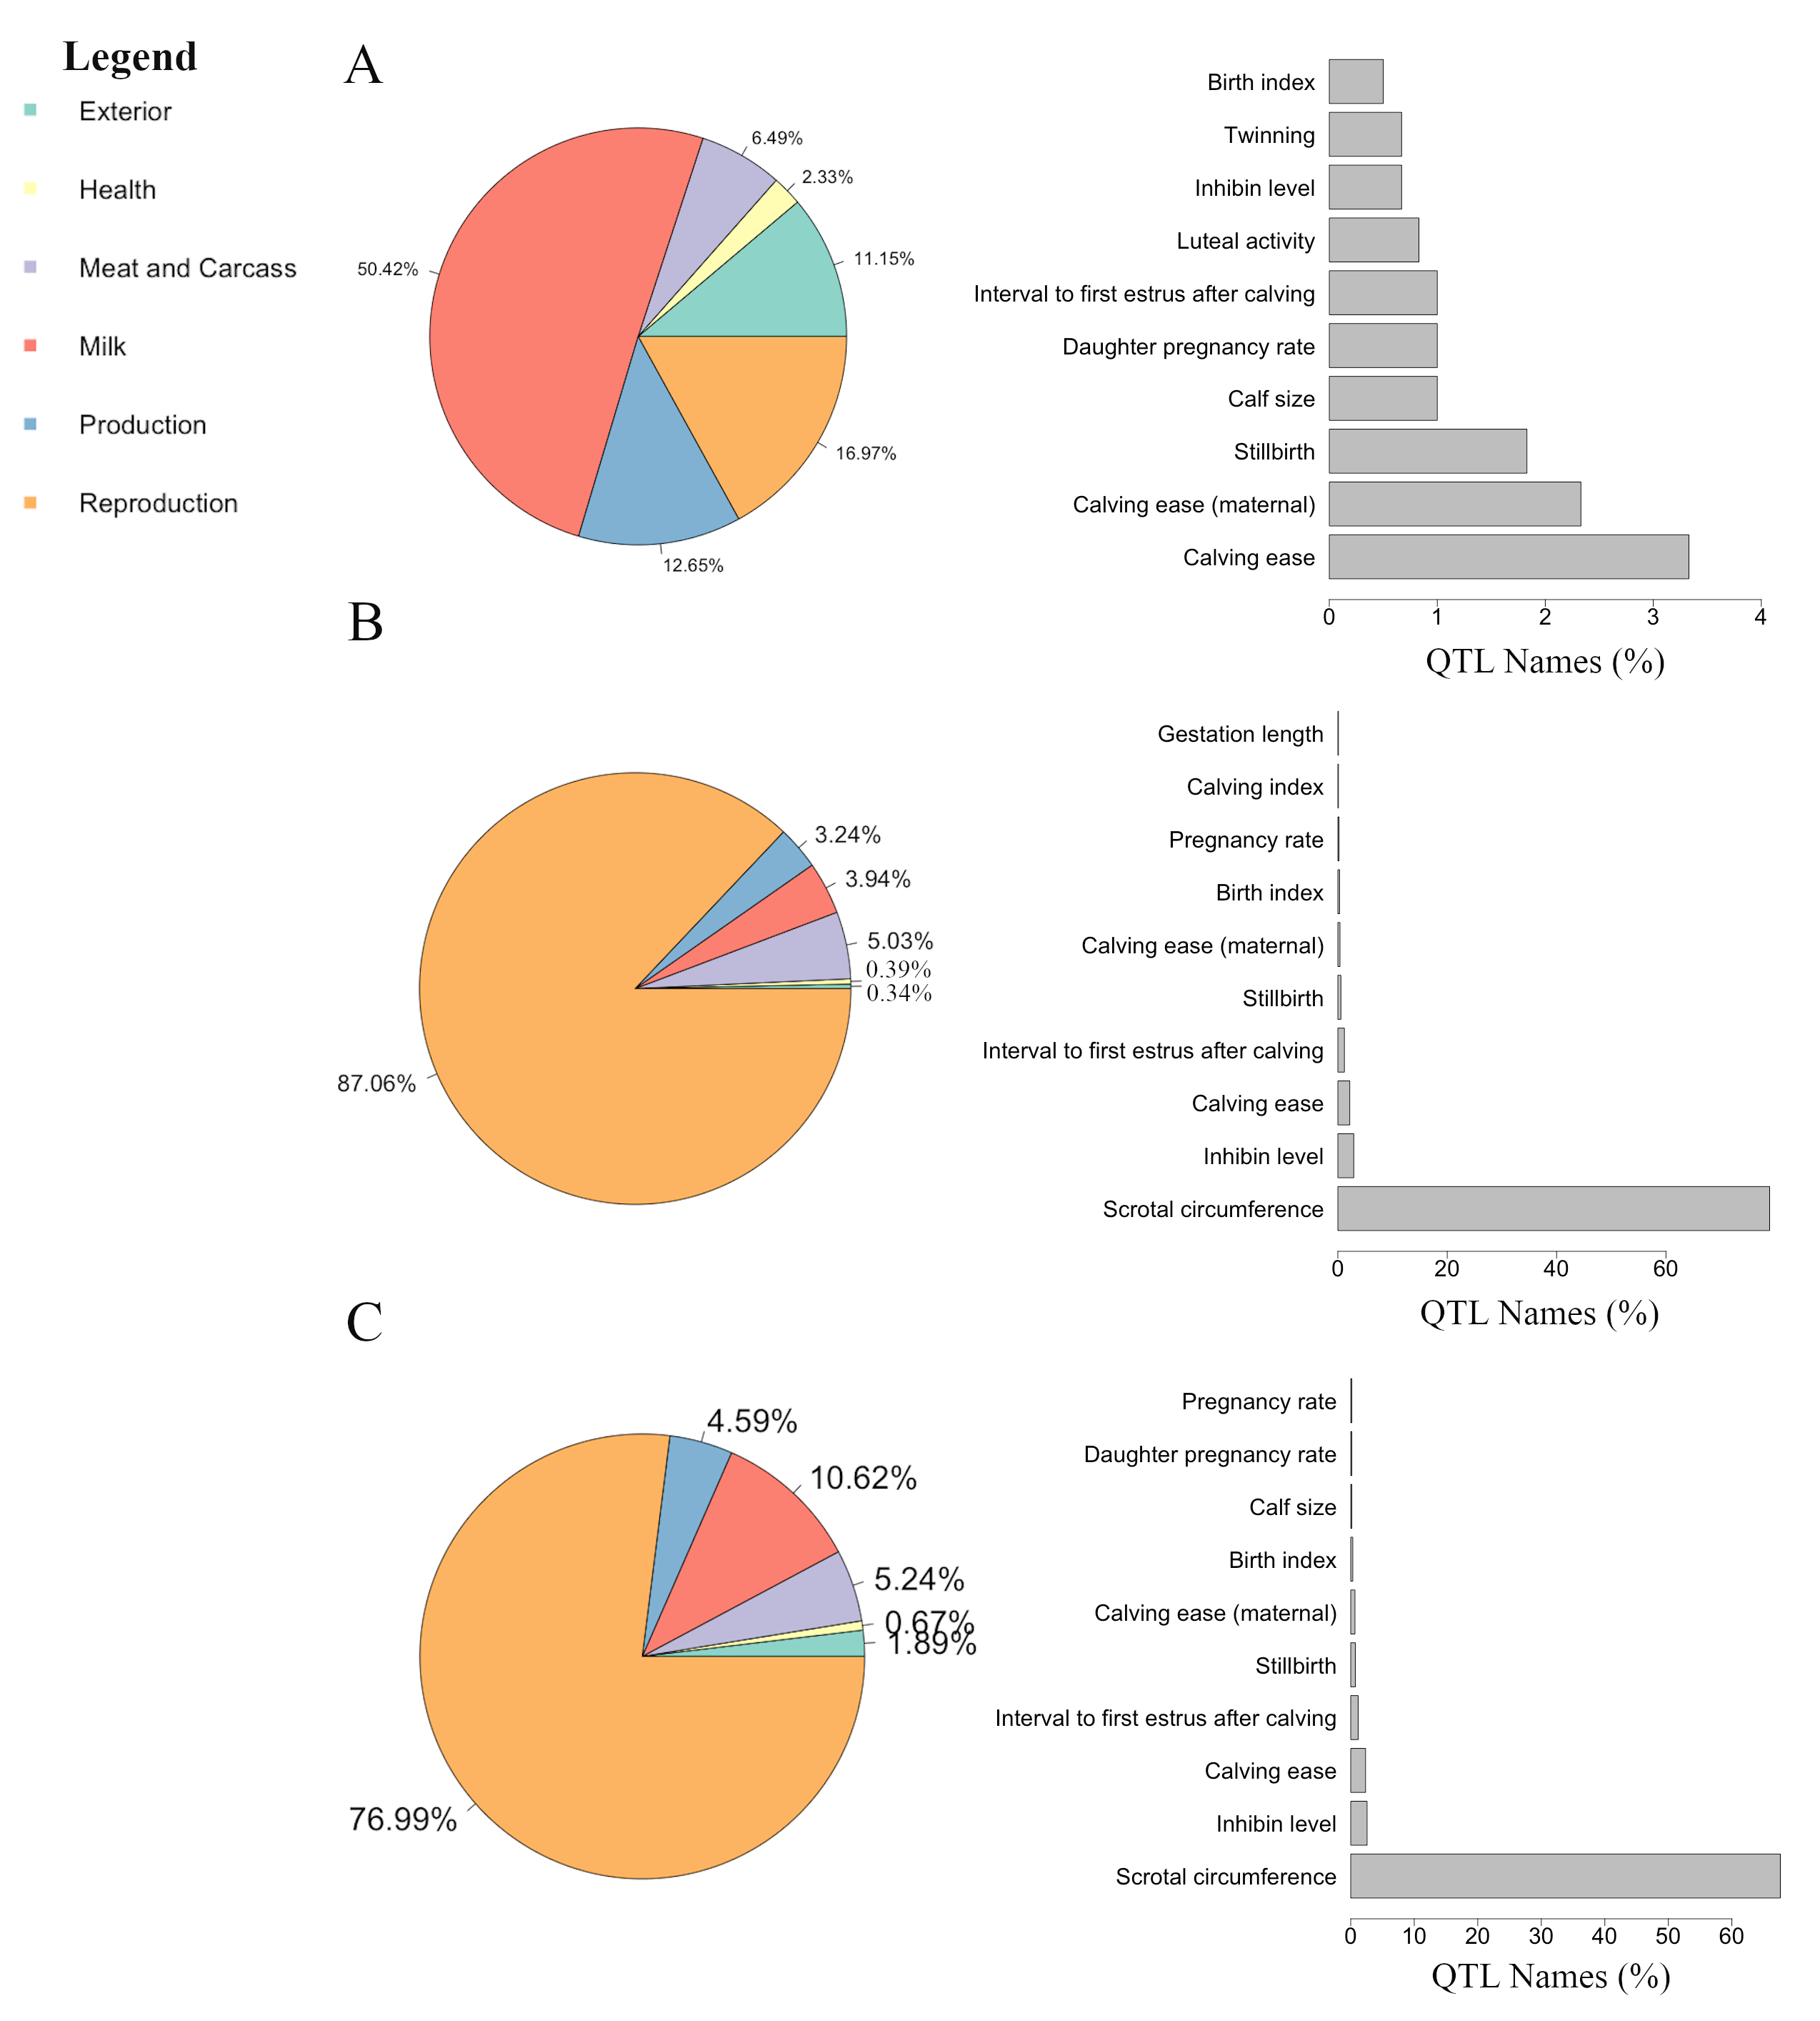
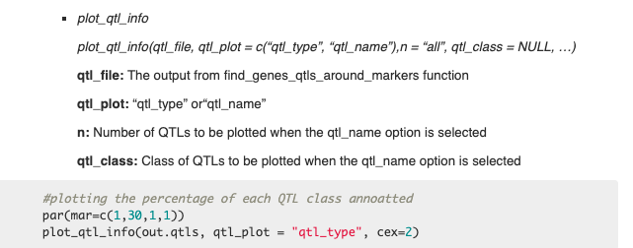
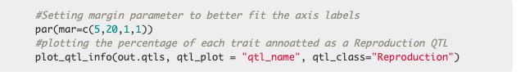
Plot QTL annotation
plot_qtl_info(qtl_file, qtl_plot = c(“qtl_type”, “qtl_name”),n = “all”, qtl_class = NULL, …)

Slide 24
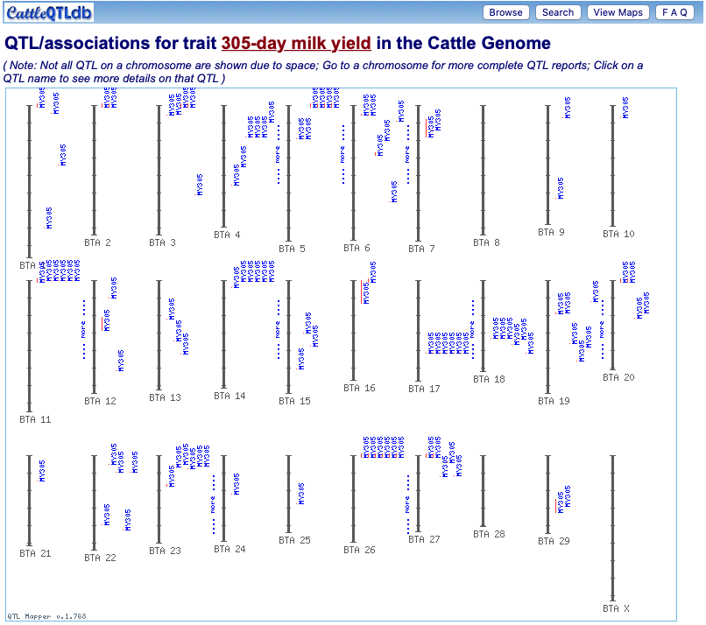
QTL Enrichment
The simple bias of investigation
The simple investigation of the proportion of each QTL type might not be totally useful

Slide 25
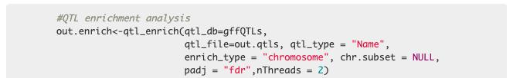
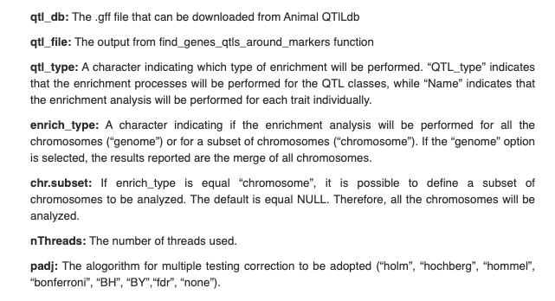
QTL Enrichment
qtl_enrich(qtl_db, qtl_file, qtl_type = c(“QTL_type”, “trait”),enrich_type = c(“genome”, “chromosome”), chr.subset = NULL, nThreads = NULL,
padj = c(“holm”, “hochberg”,“hommel”, “bonferroni”, “BH”, “BY”, “fdr”, “none”))
Hypergeometric test for enrichment of QTL classes and/or traits genome or chromosome-wise

Slide 26
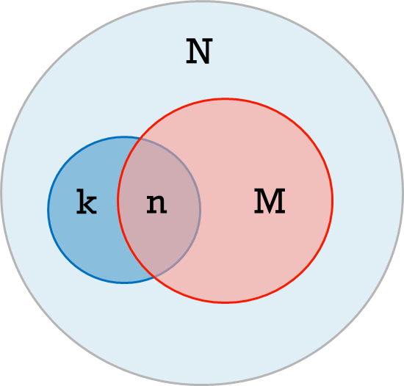
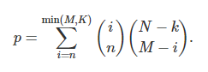
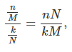
QTL Enrichment
Where,
N= total number of records in the db
k= total number of records in cadidate regions
M= total number of records for a trait in the db
n= number of records in cadidate regions for a trait
Enrichment factor
Indicates how many fold more given trait records are found in our candidate list compared to what would have been expected by chance
Probability of obtaining n or more trait records, forming a cumulative hypergeometric distribution

Slide 27
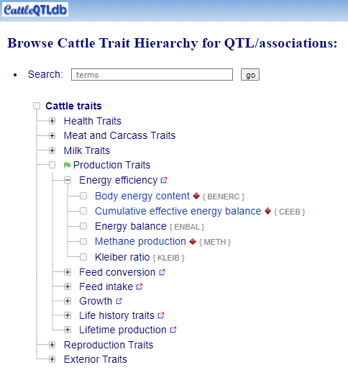
QTL Enrichment
Enrichment by:
QTL categories (Health, Meat and Carcass, Milk, Reproduction, and Exterior)
Traits

Slide 28
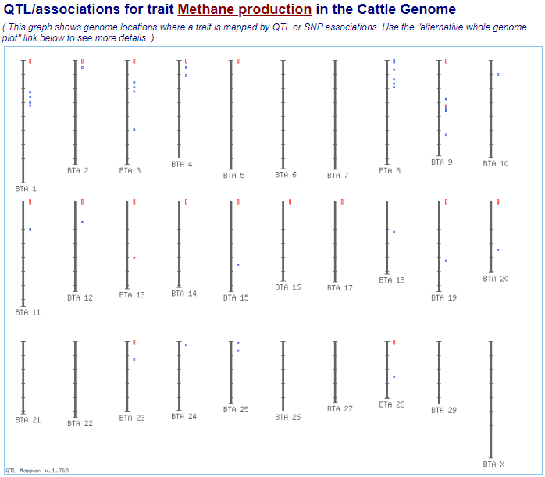
QTL Enrichment
Enrichment by:
Genome-wide
Chromosome-wide

Slide 29
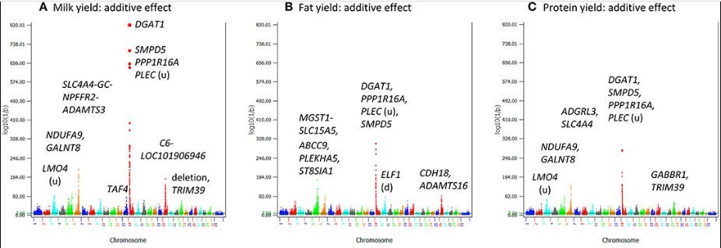
QTL Enrichment
Jiang et a. (2019)
BTA14 for milk-related traits in cattle

Slide 30
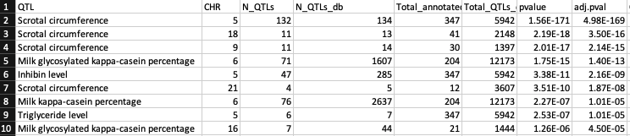
QTL Enrichment
The output from the qtl_enrich function is a data frame composed by 9 columns:
QTL: The QTL class or trait used for the enrichment;
CHR: The chromosome for that specific QTL or trait (if the option “chromosome” is informed to the argument enrich_type);
3) N_QTLs: Number of observed QTLs or traits in the dataset;
4) N_QTLs_db: Number of each annotated QTL in the qTL database;
5) Total_annotated_QTLs: Total number of annotated QTLs;
6) Total_QTLs_db: Total number of QTLs in the QTL database;
7) pvalue: P-value for the enrichment analysis;
8) adj.pval: The adjusted p-value based on the multiple test correction selected by the user;
9) QTL_type= The QTL type for each annotated trait.

Slide 31
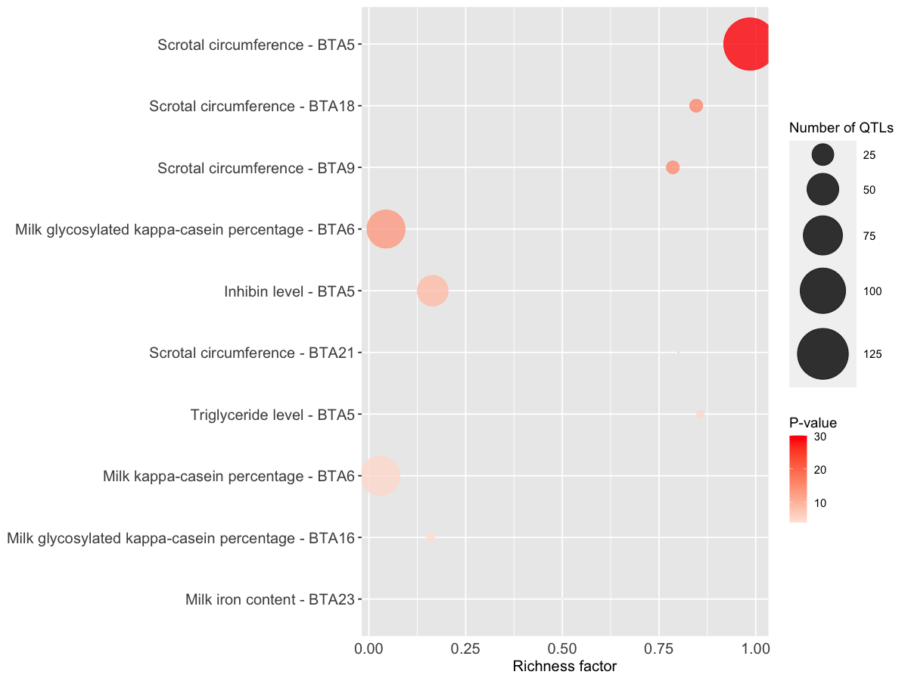
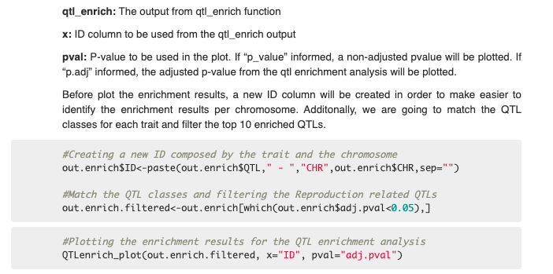
QTL Enrichment
QTLenrich_plot(qtl_enrich, x, pval)

Slide 32

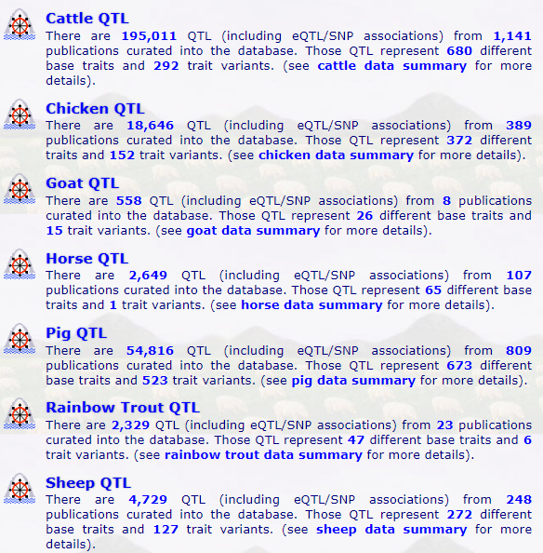
QTL Enrichment
Enrichment in function of a db
Results might be affected by trait and species
Carefully interpreted

Slide 33
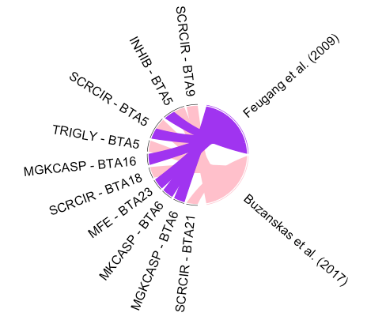
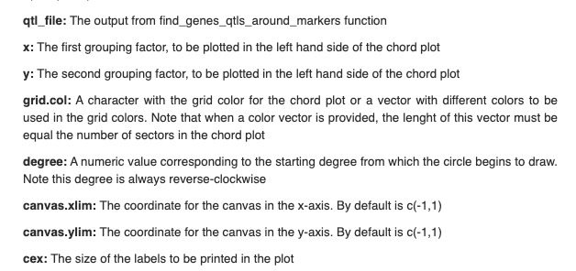
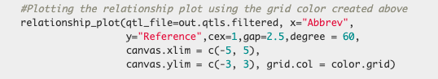
Relationship plot
relationship_plot(qtl_file, x, y, grid.col = “gray60”, degree = 90,canvas.xlim = c(-2, 2), canvas.ylim = c(-2, 2), cex)

Slide 34
Repositories
Official repository (CRAN)
https://cran.r-project.org/web/packages/GALLO/index.html
Github
https://github.com/pablobio/GALLO
Vignette
https://rpubs.com/pablo_bio/GALLO_vignette

Slide 35
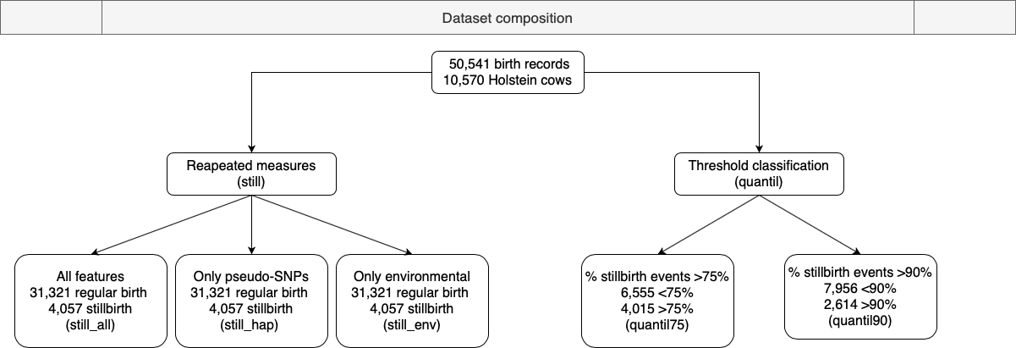
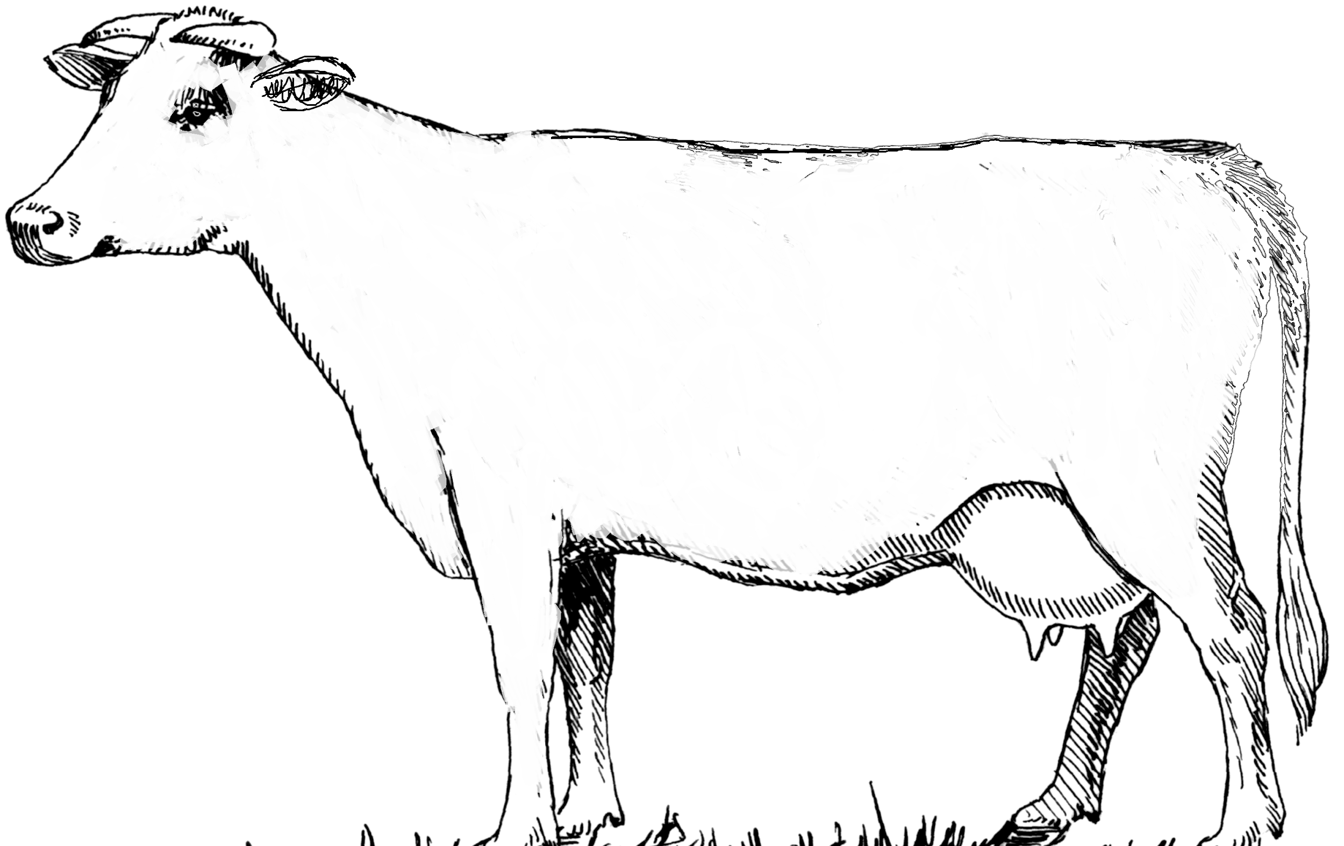
GALLO usage – example 1
High-risk of SB
Low-risk of SB

Slide 36

GALLO usage – example 1
2 linear models
5 ML models
Naive Bayes (naivebayes)
Random Forest (RF)
Multi-Layer Perceptron multiple layers (mlpWeightDecayML)
L2 Regularized Linear Support Vector Machines with Class Weights (svmLinearWeights2)
Extreme gradient boosting (xgboost)
Generalized Linear Model (glm) Bayesian
Generalized Linear Model (bayesglm)
7 models x 5 scenarios =
35 predictive scenarios

Slide 37


GALLO usage – example 1

Slide 38

GALLO usage – example 1
Still_all xgboost
Quantil75 xgboost
When the two best predictive scenarios are compared still_all (balanced accuracy = 0.675) and quantil75 (balanced accuracy = 0.625), the improvement in accuracy caused by each pseudo-SNPs is similar

Slide 39


GALLO usage – example 1
Still_all
quantil75
QTL enrichment results for reproduction related traits annotated within the genomics coordinates of the top 100 pseudo-SNP
Trait | Number QTLs | P-value | FDR | group
Interval from first to last insemination | 185 | 8.66x10⁻²⁴⁸ | 6.28x10⁻²⁴⁶ | still_all
Interval to first estrus after calving | 215 | 2.87x10⁻²⁰⁵ | 1.39x10⁻²⁰³ | still_all
Calving ease | 228 | 1.96x10⁻⁹⁹ | 7.11x10⁻⁹⁸ | still_all
Heifer pregnancy | 4 | 1.30x10⁻⁰⁵ | 0.0002 | still_all
Sperm concentration | 2 | 0.0032 | 0.0356 | still_all
Gestation length | 22 | 6.62x10⁻⁰⁹ | 2.14x10⁻⁰⁷ | quantil75
Stillbirth (maternal) | 13 | 5.07x10⁻⁰⁵ | 0.0008 | quantil75
Calving ease (maternal) | 18 | 9.03x10⁻⁰⁵ | 0.0012 | quantil75
Daughter pregnancy rate | 15 | 0.0076 | 0.0324 | quantil75
Inhibin level | 7 | 0.0095 | 0.0370 | quantil75

Slide 40
Thank you
psouf@unileon.es

